Slide 1

capstone project Splitting a String Into Descending Consecutive Values Presented by: E.Leeladhar sai(192211479) guided by: Dr. R. Dhanalakshmi
CSA0695 Design and Analysis of Algorithms for Open Addressing Techniques

Slide 2
PROBLEM STATEMENT:
Splitting a String Into Descending Consecutive Values
You are given a string s that consists of only digits.
Check if we can split s into two or more non-empty substrings such that the numerical values of the substrings are in descending order and the difference between numerical values of every two adjacent substrings is equal to 1.
For example, the string s = "0090089" can be split into ["0090", "089"] with numerical values [90,89].
. A substring is a contiguous sequence of characters in a string.

Slide 3
ABSTRACT:
This project explores the problem of splitting a string of digits into two or more non-empty substrings such that the numerical values of the substrings are in descending order, with the difference between adjacent values being exactly one.
The objective is to develop an efficient algorithm capable of checking if such a split is possible.
Edge cases, such as strings with leading zeros or strings that cannot form a valid sequence, are also considered in the implementation.
INTRODUCTION:
String manipulation problems, especially those involving numerical substrings, are common in both competitive programming and real-world applications.

Slide 4
.The ability to split a string into valid numerical sequences with specific properties requires both a strong understanding of string manipulation and recursive problem-solving techniques.
APPROACH:
Iterate through the String: Start at the beginning of the string and check each possible substring.
Validate Consecutiveness: For each substring, check if it forms a number that is part of a consecutive descending sequence.
Extract Values: Once a valid descending sequence is identified, record these values and continue with the remaining part of the string.

Slide 5
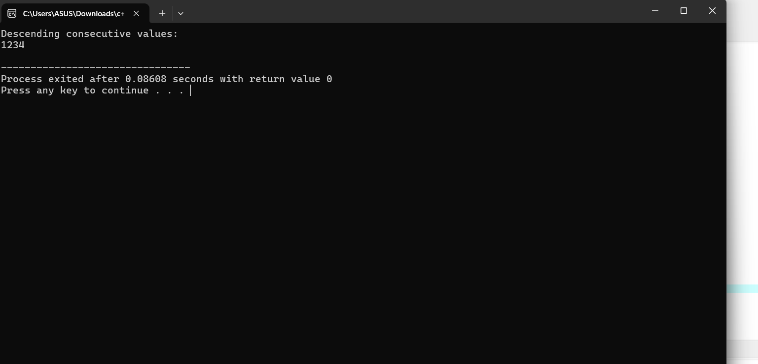
Repeat: Continue this process until the entire string has been processed or no more valid descending sequences can be found.

Slide 6
COMPLEXITY ANALYSIS:
Time Complexity: The time complexity of the program is determined by the number of ways the string can be split into substrings and the length of the string
BEST CASE:
The best case occurs when the string can be split early into valid substrings. For example, a string like "4321" can be quickly identified as unsplittable since no valid splits are possible.
WORST CASE:
The worst case occurs when the string requires exhaustive exploration of all possible split

Slide 7
AVERAGE CASE:
Depending on the distribution of digits, the recursive exploration may not need to explore all possible
FUTURE SCOPE:
The future scope for splitting a string into descending consecutive values spans multiple areas, including optimization algorithms for performance improvements, parallel processing, and applications in natural language processing (NLP) for text segmentation and data extraction

Slide 8
CONCLUSION:
The project successfully addresses the problem of determining whether a string can be split into descending consecutive values. By employing a recursive backtracking approach, the algorithm explores various possible ways to partition the string, ensuring that the resulting numerical values meet the conditions of descending order and differ by exactly one.

